Slide 1
1st GEDE DO Meeting
Wednesday, 27.6 from 10 to 12 am CEST URL: https://global.gotomeeting.com/join/177773245.

Slide 2
Purpose
first meeting is a warming up to be ready in September
starting point is the EUDOn proposal (decision in November)
but should start discussing now
why?
much work ongoing in RDA, C2CAMP, DONA, RDO, etc.
pressure to deliver is high
need agreed specifications
need to see what is out there in RI and of relevance
EOSC framework in Europe

Slide 3
Agenda
some admin issues (Peter)
email list
doc share
brief report about the EUDOn proposal (Dimitris)
brief report about DO related activities in the realm of RDA
RDA DFT definition about DO (Peter)
Data Fabric/Collections/Kernel Info/etc. (Tobias)
C2CAMP and discussion about the DO Interface/Access Protocol (Peter)
next steps
collecting information about relevant activities asap (docs and refs)
extraction of assertions from various docs to understand the landscape during summer break
understanding the scientific motivation behind DOs
need a web-site
preparing the September meeting (5th September 10.00 CEST)
other issues of relevance (calls, etc.)

Slide 4
Admin Details
Co-Chairs: Dimitris Koureas, Koenraad de Smed, Peter Wittenburg
V&V hosting the GEDE work
Zsuzsanna helping us to get the admin/organisation done
zsuzsanna.szeredi@gmail.com
funding support from RDAEU4 project not yet clarified
Email list (hosted by MPCDF): rdaeu-gede-do@mpcdf.mpg.de
>100 experts included – need help to manage this list
sending is not moderated – don‘t reply to all
Doc Share (hosted by MPCDF)
let‘s start simple – if EUDOn accepted better interaction tools are needed
with 100+ people share to be moderated
send emails to Zsuzsanna and/or Peter (peter.wittenburg@mpcdf.mpg.de)
address: https://datashare.rzg.mpg.de/s/r2khPzQRBGTvL58 Password: GEDE
timing of VM (10.00 CEST not optimal for China)

Slide 5
Share Structure
address: https://datashare.rzg.mpg.de/s/r2khPzQRBGTvL58 Password: GEDE
blockchain
citation
digital objects DO-Documents (6)
GEDE General EUDOn-Proposal (1)
repositories GEDE-DO Discussions (0)
GEDE-DO Meetings (0)

Slide 6
EUDOn Overview (Dimitris)
EUDOn COST Proposal submitted – supported by 100+ experts
received many comments – tried to integrate them in the proposal
not everyone could be mentioned as supporters in the proposal – was too much work when finalising the proposal
recently Zsuzsanna and Peter checked all emails which were received and sent emails to all which could not be integrated anymore at the end
will expand the GEDE-DO email list soon
decision by COST expected in November 2018
EUDOn needs to be closely related with RDA activities
some content aspects

Slide 7
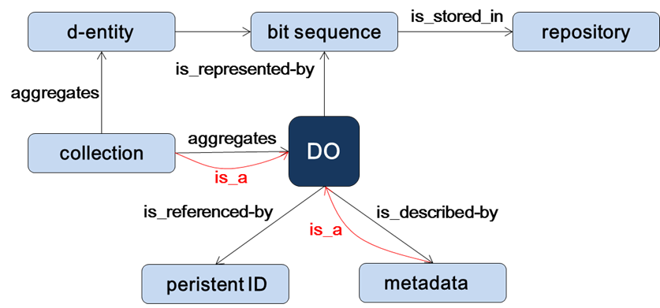
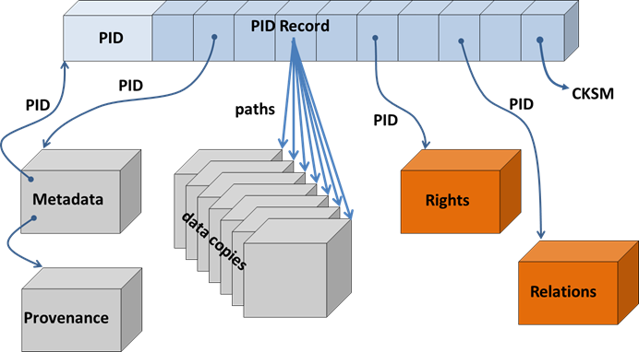
RDA DFT Definition of DO
DOs are conceptual: scientifically meaningful entities
DOs are anchors in dynamic data universe
DOs: atomic or collections
DOs: data, metadata, software, etc.
PIDs can act as binding glue
different types of metadata
need typed attributes
machines can find all relevant information of DO

Slide 8
RDA Activities
Data Fabric
analysis of the data fabric challenges in the big data labs
work on essential components
discussing role of DOs and testbed concept
kick off kernel IG
kick off C2CAMP
Collections
provided a collection API
Kernel Information
see next slide

Slide 9
PID Kernel Information WG
Final recommendation to be submitted soon
Recommendation contents (available from group homepage):
Guiding Principles for designing and using PID Kernel Information
Draft profile with kernel properties
General high-level architecture
Adoption and usage scenarios
Still open fur further use cases

Slide 10


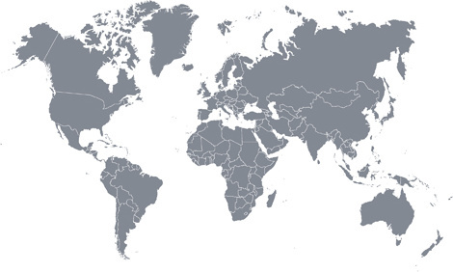
C2CAMP Activities
some research infrastructures (ICOS, CLARIN, DISSCO, ENES)
some typical data centers working closely with communities
some HPC centers working also with communities
some IT providers
some more centres/groups now involved
all grown from close RDA collaborations and joint priorities
all agree that scientific cases are in the driving seat
all have shown commitment and competence
some institutions who want to implement now

Slide 11
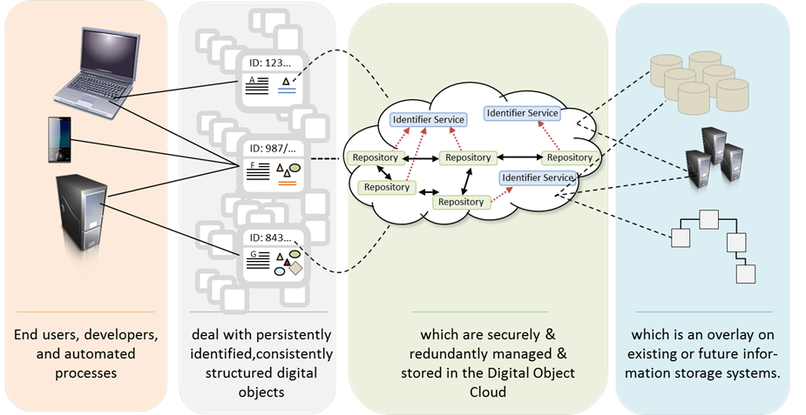
DFIG/C2CAMP Activities

Slide 12


DFIG/C2CAMP Activities
massiveness of data streams and wish to re-combine data requires radical shifts
Agents should react on incoming data which are suitable for the specific business case
digital objects “find themselves”
Data Events
Structured
Data Markets
Data Federation
Agents
Data Type Registry
Processing services
result
scripts

Slide 13
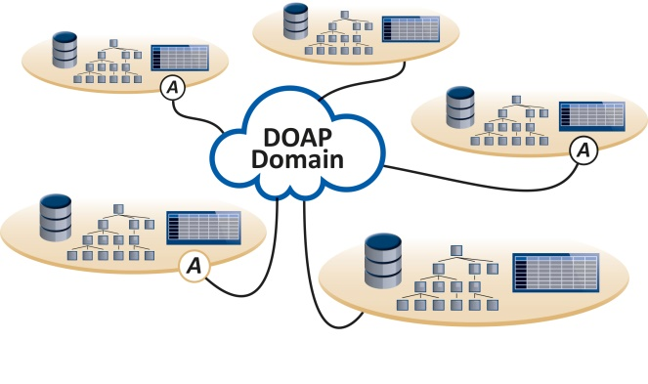
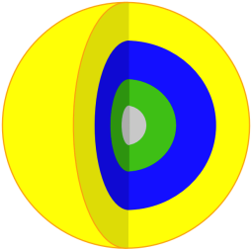

C2CAMP First Priority: DOIP/DOAP
DOIP
caller
DO
Elements of an abstract DOIP definition (according to Larry):
CallerID: ID of the entity requesting invocation of an operation
ObjectID: ID of the DO to be operated upon
OperationID: ID that specified the operation to be performed
Input: structured stream of bytes that contains the input to the operation (parameters, content)
Output: structured stream of bytes that contains the output of the operation (content, messages)

Slide 14
Next Steps
collecting information about relevant activities asap (docs and refs)
extraction of assertions from various docs to understand the landscape during summer break
understanding the scientific motivation behind DOs
need a web-site
preparing the September meeting (5th September 10.00 CEST)
other issues of relevance (EOSC, calls, etc.)

